Slide 1
Data and Annotation

Slide 2

Annotated Data
English | Wikipedia The Little Prince 20 Thousand Leagues under the Sea The English Web Treebank (online reviews) Wall Street Journal (financial news)
German | The Little Prince 20 Thousand Leagues under the Sea
French | The Little Prince 20 Thousand Leagues under the Sea
Hebrew | The Little Prince Wikipedia - annotation underway
Russian | The Little Prince - annotation underway

Slide 3
The Annotation Process
Each task is annotated and reviewed by trained annotators
Means of communication with annotators:
annotators can leave comments inside the task itself
meetings

Slide 4
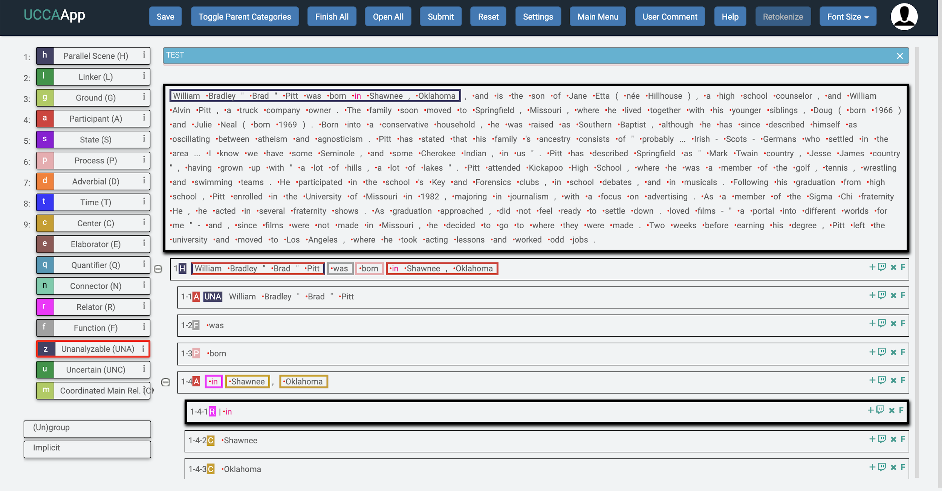
UCCA-App
Open source, flexible web application
UCCA annotation is done on the UCCA-App
Supports syntactic and semantic phrase-based annotation in general
Simple and intuitive UI, supports annotation by non-experts

Slide 5
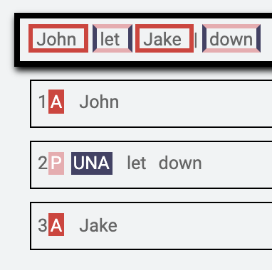
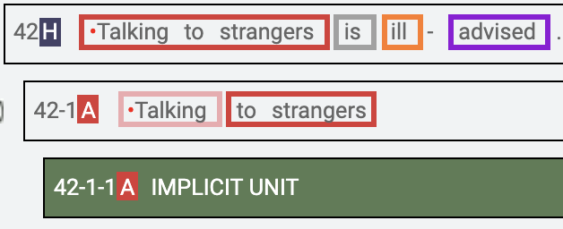
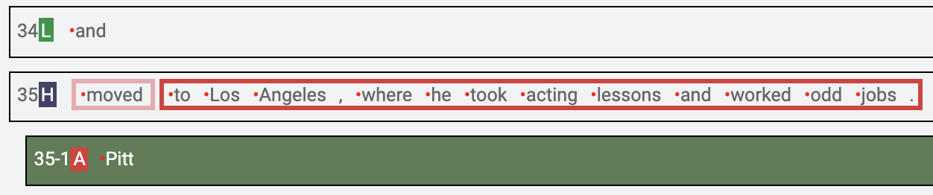
UCCA-App
Supports various properties such as:
Discontiguous phrases
Implicit sub-units (empty elements)
Remote sub-units (by allowing multiple parents)
Multi-layered architecture: extension and refinement layers (found useful)

